Slide 1
Vector Semantics and Embeddings
Thanks to Dr. Ashraf Uddin Sir

Slide 2
Vector Semantics and Embeddings
Words that occur in similar contexts tend to have similar meanings.
Vector semantics instantiates learning representations of the meaning of words, called embeddings, directly from their distributions in texts.
These representations are used in every natural language processing application that makes use of meaning, and the static embeddings we introduce here underlie the more powerful dynamic or contextualized embeddings like BERT.

Slide 3
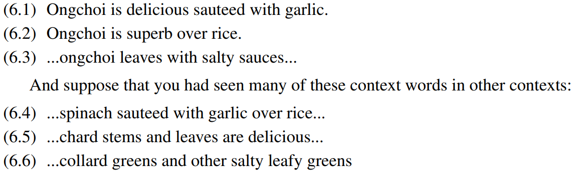
Vector Semantics
Vectors semantics is the standard way to represent word meaning in NLP, helping us model many of the aspects of word meaning .
For example, suppose you didn’t know the meaning of the word ongchoi (a recent borrowing from Cantonese) but you see it in the following contexts:

Slide 4
Vector Semantics
The fact that ongchoi occurs with words like rice and garlic and delicious and
salty, as do words like spinach, chard, and collard greens might suggest that ongchoi is a leafy green similar to these other leafy greens. We can do the same thing computationally by just counting words in the context of ongchoi

Slide 5
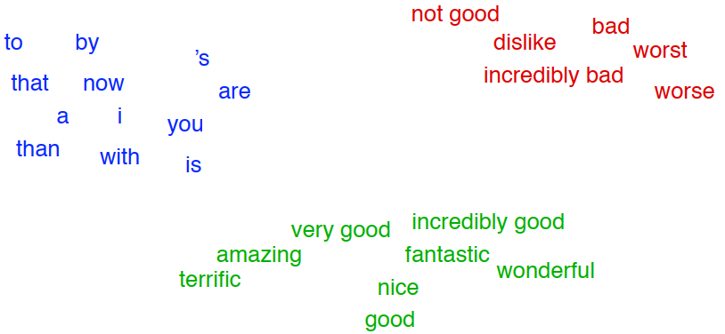
Vector Semantics
The idea of vector semantics is to represent a word as a point in a multidimensional semantic space that is derived from the distributions of word neighbors. Vectors for representing words are called embeddings (more strictly applied only to dense vectors like word2vec).
A two-dimensional projection of embeddings for some words and phrases, showing that words with similar meanings are nearby in space. The original 60-dimensional embeddings were trained for sentiment analysis.

Slide 6
Vector Semantics
The fine-grained model of word similarity of vector semantics offers enormous
power to NLP applications.
NLP applications like the sentiment classifiers depend on the same words appearing in the training and test sets. But by representing words as embeddings, classifiers can assign sentiment as long as it sees some words with similar meanings.
And as we’ll see, vector semantic models can be learned automatically from text without supervision.

Slide 7
Vector Semantics
We’ll introduce the two most commonly used models. In the tf-idf model, an important baseline, the meaning of a word is defined by a simple function of the counts of nearby words. We will see that this method results in very long vectors that are sparse, i.e. mostly zeros (since most words simply never occur in the context of others).
We’ll introduce the word2vec model family for constructing short, dense vectors that have useful semantic properties. We’ll also introduce the cosine, the standard way to use embeddings to compute semantic similarity, between two words, two sentences, or two documents, an important tool in practical applications like question answering, and summarization.

Slide 8
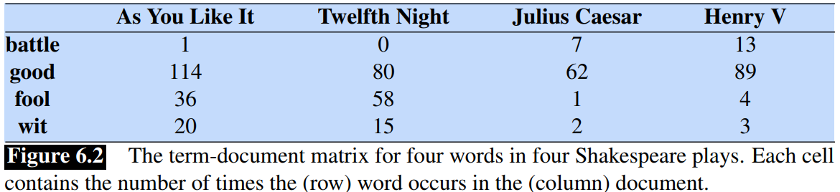
Words and Vectors
Vector or distributional models of meaning are generally based on a co-occurrence matrix, a way of representing how often words co-occur. We’ll look at two popular matrices: the term-document matrix and the term-term matrix.
In a term-document matrix, each row represents a word in the vocabulary and each column represents a document from some collection of documents.

Slide 9
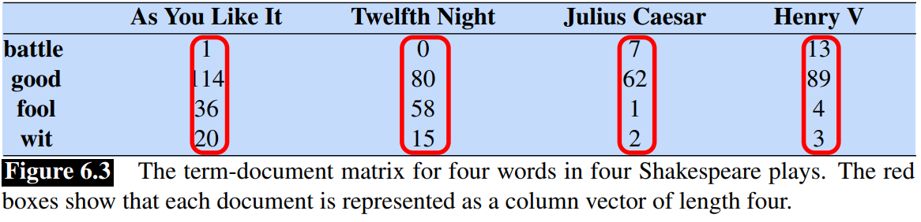
Words and Vectors
We can think of the vector for a document as a point in |V|-dimensional space;
Thus, the documents in Fig. 6.3 are points in 4-dimensional space.
A real term-document matrix, of course, wouldn’t just have 4 rows and columns. More generally, the term-document matrix has |V| rows (one for each word type in the vocabulary) and D columns (one for each document in the collection.

Slide 10
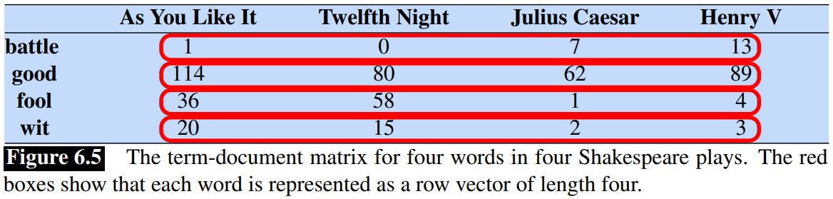
Word as vector
We’ve seen that documents can be represented as vectors in a vector space. But
vector semantics can also be used to represent the meaning of words. We do this row vector by associating each word with a word vector— a row vector rather than a column vector, hence with different dimensions, as shown in Fig

Slide 11
Word as vector
An alternative to using the term-document matrix to represent words as vectors of document counts, is to use the term-term matrix, also called the word-word matrix or the term-context matrix, in which the columns are labeled by words rather than documents. This matrix is thus of dimensionality |V|×|V|
The context could be the document, in which case the cell represents the number of times the two words appear in the same document. It is most common, however, to use smaller contexts, generally a window around the word, for example of 4 words to the left and 4 words to the right, in which case the cell represents the number of times (in some training corpus) the column word occurs in such a ±4 word window around the row word.

Slide 12
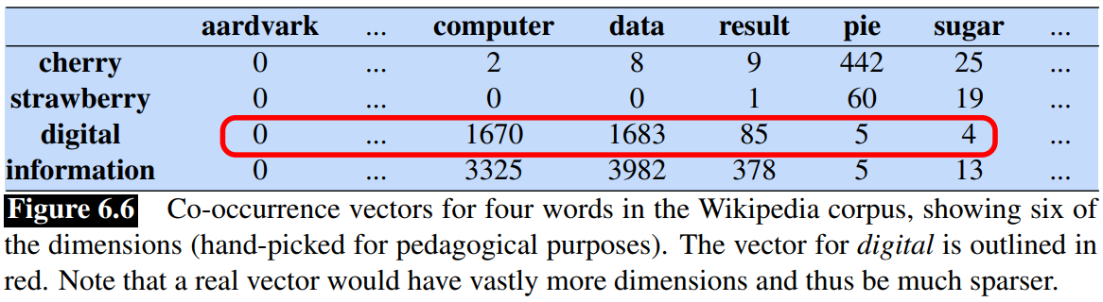
Word as vector
If we take every occurrence of each word (say strawberry) and count the context words around it, we get a word-word co-occurrence matrix.
Note in Fig. 6.6 that the two words cherry and strawberry are more similar to each other (both pie and sugar tend to occur in their window) than they are to other words like digital; conversely, digital and information are more similar to each other than, say, to strawberry.

Slide 13
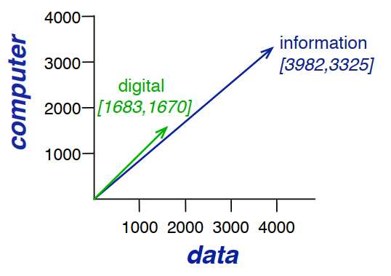
Word as vector
A spatial visualization of word vectors for digital and information, showing just
two of the dimensions, corresponding to the words data and computer.

Slide 14
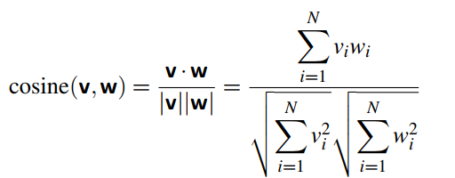
Cosine for measuring similarity
To measure similarity between two target words v and w, we need a metric that
takes two vectors (of the same dimensionality, either both with words as dimensions, hence of length |V|, or both with documents as dimensions as documents, of length |D|) and gives a measure of their similarity.
By far the most common similarity metric is the cosine of the angle between the vectors.

Slide 15
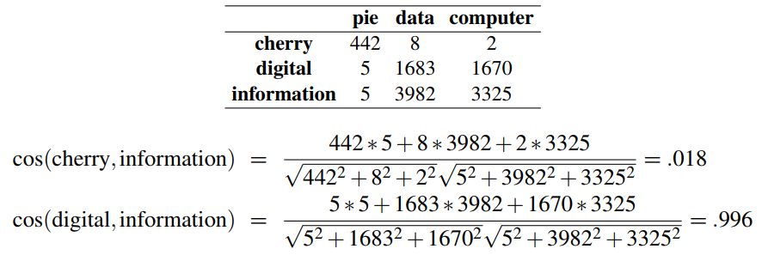
Cosine for measuring similarity
Let’s see how the cosine computes which of the words cherry or digital is closer
in meaning to information, just using raw counts from the following shortened table:

Slide 16
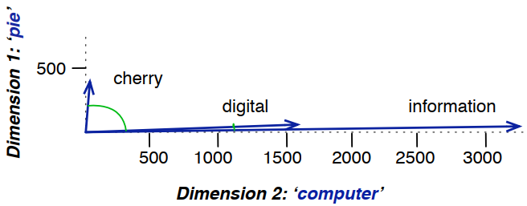
Cosine for measuring similarity
A (rough) graphical demonstration of cosine similarity, showing vectors for three words (cherry, digital, and information) in the two dimensional space defined by counts of the words computer and pie nearby.

Slide 17


TF-IDF: Weighing terms in the vector
The co-occurrence matrix represents each cell by frequencies, either of words with documents, or words with other words. But raw frequency is not the best measure of association between words. Raw frequency is very skewed and not very discriminative.
The tf-idf weighting is the product of two terms, each term capturing one of these two intuitions:
The first is the term frequency: the frequency of the word t in the document d. We can just use the raw count as the term frequency:

Slide 18

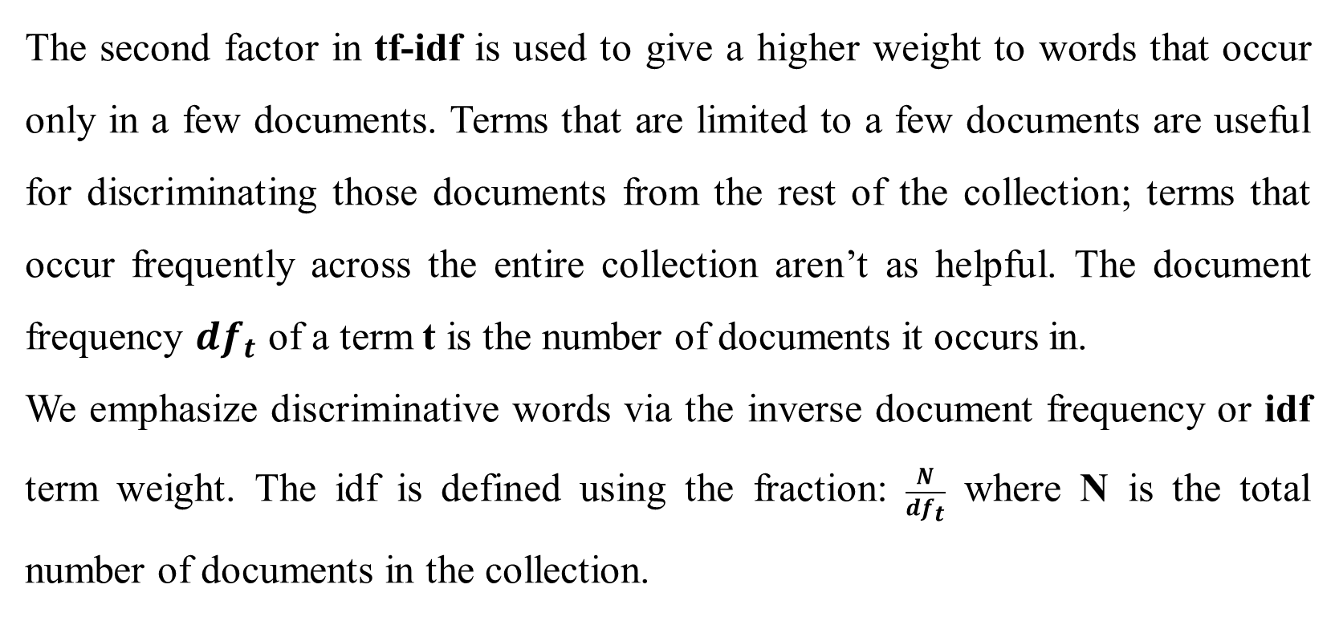
TF-IDF: Weighing terms in the vector
The second factor in tf-idf is used to give a higher weight to words that occur only in a few documents. Terms that are limited to a few documents are useful for discriminating those documents from the rest of the collection; terms that occur frequently across the entire collection aren’t as helpful. The document frequency ${df}_{t}$ of a term t is the number of documents it occurs in.
We emphasize discriminative words via the inverse document frequency or idf term weight. The idf is defined using the fraction: $\frac{N}{{df}_{t}}$ where N is the total number of documents in the collection.

Slide 19

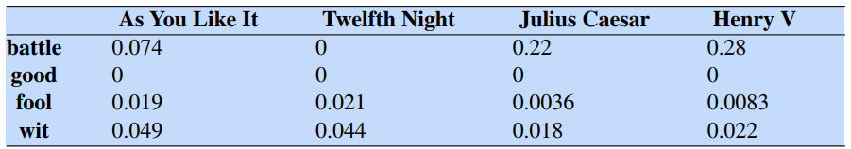
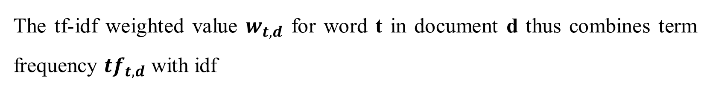
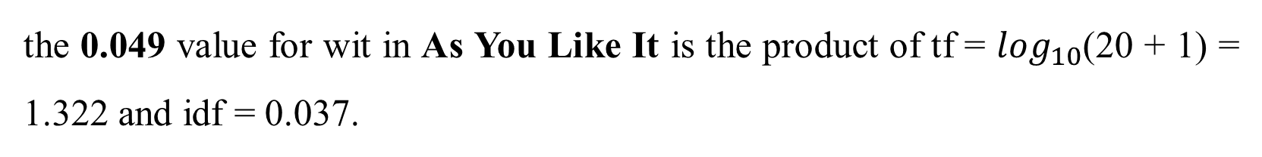
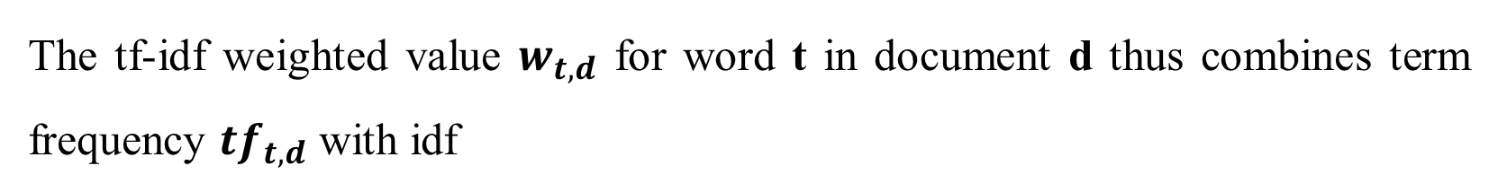
TF-IDF: Weighing terms in the vector
The tf-idf weighted value $w_{t,d}$ for word t in document d thus combines term frequency ${tf}_{t,d}$ with idf
The tf-idf weighted value $w_{t,d}$ for word t in document d thus combines term frequency ${tf}_{t,d}$ with idf
the 0.049 value for wit in As You Like It is the product of tf = $\log_{10}$(20 + 1) = 1.322 and idf = 0.037.

Slide 20

Document vector
The tf-idf model of meaning is often used for document functions like deciding
if two documents are similar. We represent a document by taking the vectors of
all the words in the document, and computing the centroid of all those vectors.
The centroid is the multidimensional version of the mean; the centroid of a set of vectors is a single vector that has the minimum sum of squared distances to each of the vectors in the set. Given k word vectors w1;w2;:::;wk, the centroid document vector d is:

Slide 21
Word2vec
We saw how to represent a word as a sparse, long vector with dimensions corresponding to words in the vocabulary or documents in a collection.
We now introduce a more powerful word representation: embeddings, short dense vectors.
It turns out that dense vectors work better in every NLP task than sparse vectors.
Representing words as 300-dimensional dense vectors requires our classifiers to learn far fewer weights than if we represented words as 50,000-dimensional vectors, and the smaller parameter space possibly helps with generalization and avoiding overfitting.

Slide 22
Word2vec
Dense vectors may also do a better job of capturing synonymy.
For example, in a sparse vector representation, dimensions for synonyms like car and automobile dimension are distinct and unrelated; sparse vectors may thus fail to capture the similarity between a word with car as a neighbor and a word with automobile as a neighbor.
We introduce one method for computing embeddings: skip-gram with negative sampling, sometimes called SGNS. The skip-gram algorithm is one of two algorithms in a software package called word2vec, and so sometimes the algorithm is loosely referred to as word2vec

Slide 23
Word2vec
The word2vec methods are fast, efficient to train, and easily available online with code and pretrained embeddings.
Word2vec embeddings are static beddings, meaning that the method learns one fixed embedding for each word in the vocabulary.
We’ll introduce methods for learning dynamic contextual embeddings like the popular family of BERT representations, in which the vector for each word is different in different contexts.
The intuition of word2vec is that instead of counting how often each word w occurs near, say, apricot, we’ll instead train a classifier on a binary prediction task: “Is word w likely to show up near apricot?”

Slide 24
Word2vec
word2vec is a much simpler model than the neural network language model, in two ways.
First, word2vec simplifies the task (making it binary classification instead of word prediction). Second, word2vec simplifies the architecture (training a logistic regression classifier instead of a multi-layer neural network with hidden layers). The intuition of skip-gram is:
1. Treat the target word and a neighboring context word as positive examples.
2. Randomly sample other words in the lexicon to get negative samples.
3. Use logistic regression to train a classifier to distinguish those two cases.
4. Use the learned weights as the embeddings.

Slide 25
Learning skip-gram embeddings
The learning algorithm for skip-gram embeddings takes as input a corpus of text, and a chosen vocabulary size N. It begins by assigning a random embedding vector for each of the N vocabulary words, and then proceeds to iteratively shift the embedding of each word w to be more like the embeddings of words that occur nearby in texts, and less like the embeddings of words that don’t occur nearby. Let’s start by considering a single piece of training data:

Slide 26
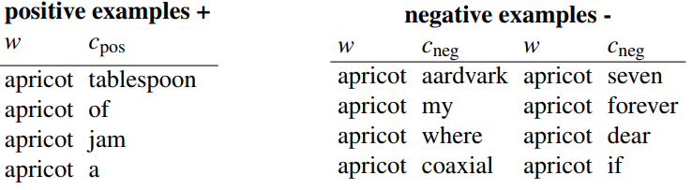
Learning skip-gram embeddings
This example has a target word w (apricot), and 4 context words in the L = ±2
window, resulting in 4 positive training instances (on the left below):

Slide 27
Other kinds of static embeddings
There are many kinds of static embeddings. An extension of word2vec, fasttext, addresses a problem with word2vec as we have presented it so far: it has no good way to deal with unknown words—words that appear in a test corpus but were unseen in the training corpus.
Another very widely used static embedding model is GloVe, short for Global Vectors, because the model is based on capturing global corpus statistics. GloVe is based on ratios of probabilities from the word-word cooccurrence matrix, combining the intuitions of count-based models while also capturing the linear structures used by methods like word2vec.

Slide 28
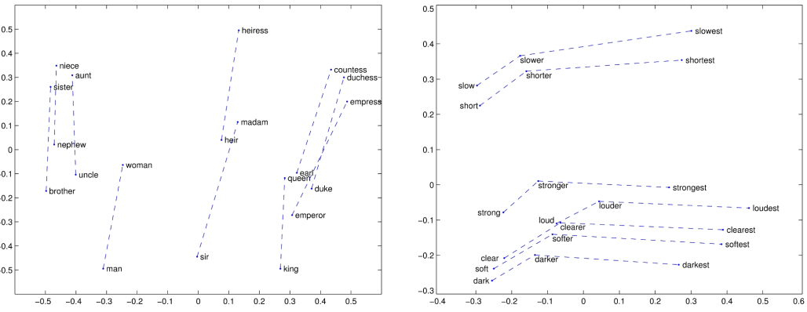
Semantic properties of embeddings
Different types of similarity or association
Analogy/Relational Similarity

Slide 29
References
Daniel Jurafsky and James H. Martin. Speech and Language Processing, 3rd edition, 2025.
https://medium.com/@shandeep92/countvectorizer-vs-tfidfvectorizer-cf62d0a54fa4
https://medium.com/@abhishekjainindore24/tf-idf-in-nlp-term-frequency-inverse-document-frequency-e05b65932f1d
https://www.analyticsvidhya.com/blog/2024/07/tf-idf-matrix/
https://scikit-learn.org/stable/modules/generated/sklearn.feature_extraction.text.TfidfTransformer.html#sklearn.feature_extraction.text.TfidfTransformer

